Slide 1
CCAP
Converged Cable Access Platform
Gerry White, Distinguished Engineer CTO Group CABU
With material shamelessly stolen from multiple industry wide CCAP Sources
July 2014

Slide 2
Agenda
Why CCAP?
What is CCAP?
Differences to current CMTS
CCAP components & implementation
Distributed CCAP / Remote PHY
NFV & Virtualized CCAP

Slide 3
Why do we need CCAP?

Slide 4

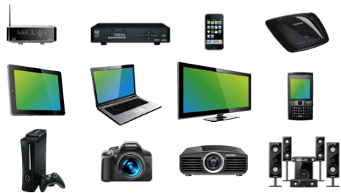
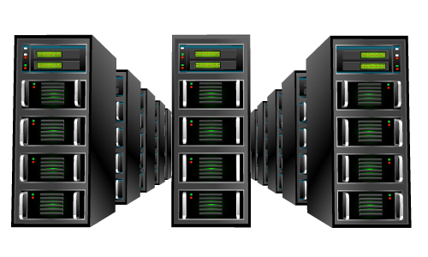



Cable Operator Challenges to Meet the Traffic Growth
More Video
More Devices
More Personal
More Interactive
Keep up with unprecedented bandwidth growth
Pressure to reduce
rack space and power
Migrate to an all-IP network
with the existing infrastructure

Slide 5
So What Exactly is CCAP?

Slide 6
CCAP Objectives
Converged multi-service platform - single port per SG
Increased DOCSIS capacity / SG
Reduced cost-per-downstream
Reduce rack space per system
Scaleable deployment options

Slide 7
Current Head End
Router
Separate CMTSs & EQAMs
Limited channel capacity per platform
Multiple platforms for each
Complex combining
Scaling problems as add SGs
broadcast
narrowcast
CMTS
OOB
UEQAM
analog
OOB
combining
Laser
Rcvr

Slide 8
CCAP Head End
Combine CMTS & EQAM
Higher performance
Single port per SG
Simpler combining
Easier scaling
Router
Digital Video and data
CCAP
OOB
analog
OOB
combining
Laser
Rcvr

Slide 9
CCAP with Analog Optical Interfaces
Router
Include optics and combining
Further space reductions
Digital Video and data
OOB
CCAP
OOB
analog
Analog optics

Slide 10
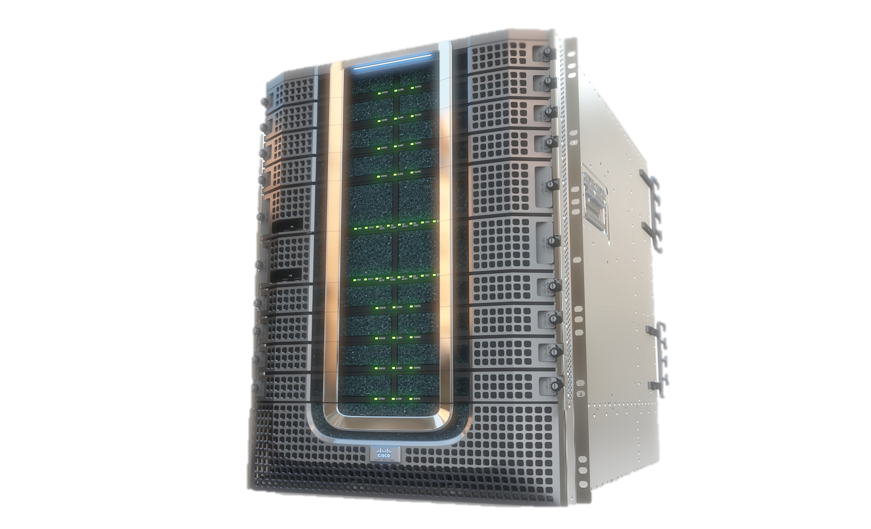
CCAP
Integration of services
One port per SG
High capacity & density
Lower costs
Efficiency & scale
Centralization of resources
Hub in box

Slide 11
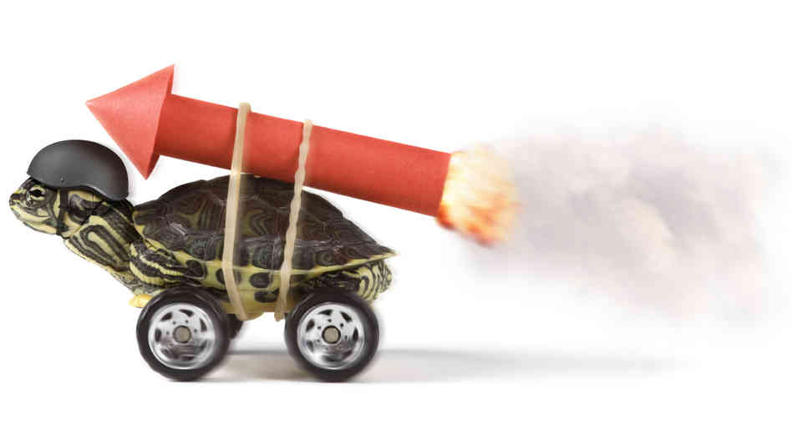
DOCSIS 3.1
Goals
  Achieve 10+ Gbps in the DS.
  Achieve 1+ Gbps in the US
  Backward compatibility story with DOCSIS 3.0, 2.0, & 1.1.
  Better spectral efficiency.
Technology
  OFDM, OFDMA, LDPC
  New DS and US spectrum
  Re-use of D3.0 MAC concepts
This will allow D3.1 to offer services competitive with FTTH.

Slide 12
CCAP Objectives
Exabytes per month
Converged multi-service platform - single port per SG
Increased DOCSIS capacity / SG
Reduced cost-per-downstream
Reduce rack space per system
Scaleable deployment options
+ DOCSIS 3.1
Year

Slide 13
Today’s Headend
IP Services
CMTS
DOCSIS
EQAM
Forward
Combiner
Data
VoIP
DOCSIS
Combining
Network
IP
Video
HFC
SG 1
VoD
EQAM
VoD
Combining
Network
Digital Video
Services
SDV
EQAM
SDV
Combining
Network
Forward
Combiner
Linear
VoD
NPVR
HFC
SG N
Broadcast
EQAM
Bcast
Combining
Network
Inefficient EQAM capacity utilization, complex combining networks

Slide 14
Integrated CCAP Architecture
Integrated CCAP
Forward
Combiner
IP Services
HFC
/PON
SG 1
Data
VoIP
IP
Video
CMTS
Digital Video
Services
Universal
EQAM
Forward
Combiner
Linear
VoD
HFC
/PON
SG N
NPVR
Increase capacity & reduce cost, rack space and power consumption
One port per SG

Slide 15
What goes into a CCAP?

Slide 16
Generic CCAP Components
Routing
Packet engines
Control & management
Supervisor & packet engine
Northbound interfaces
To core
10G Ethernet
BH PIC
DOCSIS line cards
DOCSIS + EQAM
DOCSIS line cards
Southbound interfaces
To HFC
RF or optical
Active line cards
RF PIC
Spare line card(s)
External timing
Timing
Digital and RF mid-planes

Slide 17
CCAP Front
Supervisor Cards
Integrated backhaul capacity
1+1 redundancy
N * 10G interfaces
RF Line Cards
Port per SG
Full spectrum per port
DS + US on one card or
DS cards + US cards
N+1 redundancy with integrated RF Switch
Power Supplies
5 -> 10KW

Slide 18
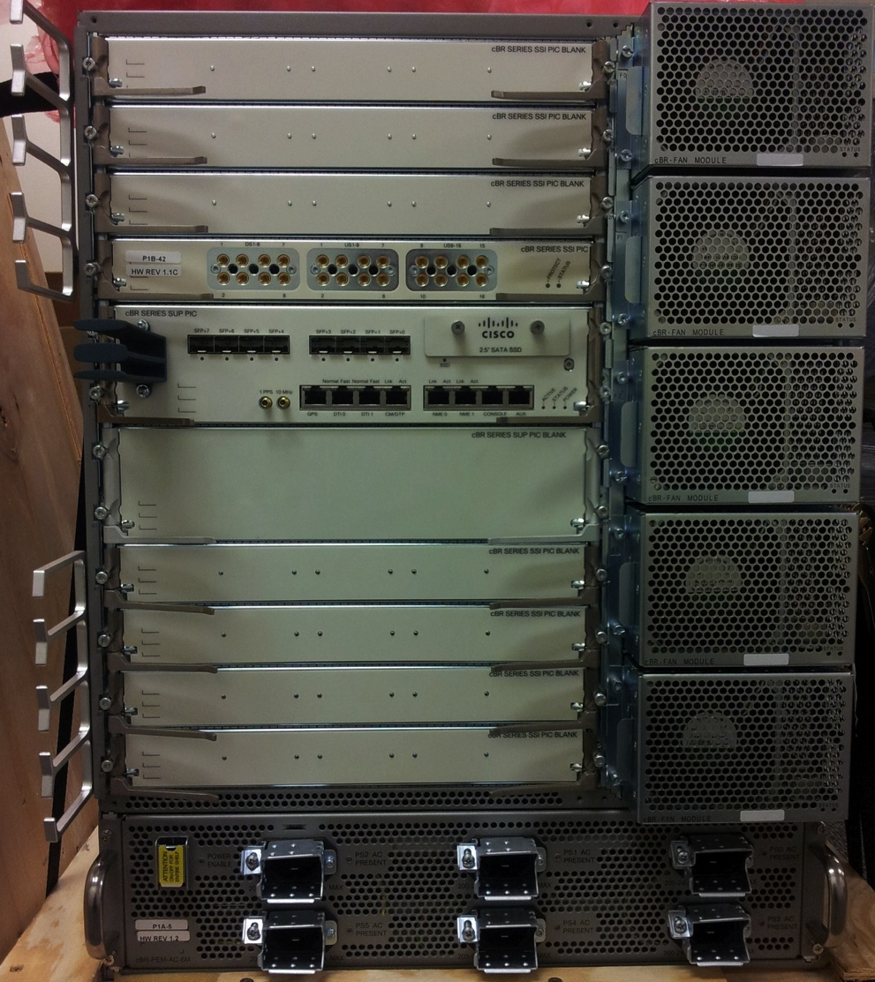
CCAP – Rear
RF Line Card PICs
High density connectors
Integrated analog optics
Remote PHY digital optics
Supervisor PICs
N x 10 GE ports
Management
Timing
Power Connections
Cooling
Exhaust fans

Slide 19
CCAP Impact
Capacity
DOCSIS 3.0 + 3.1
Scale from 1 to 10 Gbps downstream per SG
100 to 200Gbps backhaul initially – more later
Convergence
DOCSIS
IP and MPEG video
narrowcast and broadcast
Reduced costs
Next generation silicon – processing, packet forwarding, DOCSIS
High level of integration
Reduced cost per channel
Reduced space & power
Integration
Reduced combining
Integrated optics

Slide 20
CCAP & Remote Phy

Slide 21
Remote Phy Goals
Remove RF from head end / hub
Replace analog fiber from hub to node with digital
Leverage Ethernet / PON and digital optics
Extend IP networking to the node
Simplify operations
Keep the node as simple as possible
Keep the complex s/w central

Slide 22
CCAP with Centralized PHY
DOCSIS
L2
MAC
Common
L1
PHY
In a I-CCAP, the CMTS and EQAM share a common PHY
PHY provides digital to analog conversion
Clock is local to the CCAP platform
RF
Video
L2
MAC
clock

Slide 23
CCAP with Remote PHY
DOCSIS
L2
MAC
Remote
PHY
DEPI
UEPI
Remote PHY
Common
L1
PHY
Ethernet
Ethernet
RF
Video
L2
MAC
clock
clock
R-DTI
The CCAP PHY chip is remotely located and connected over Ethernet
Digital to analog occurs in the Remote PHY node
Remote DTI manages transfer of time and frequency

Slide 24

Fiber Deeper & Remote PHY
DOCSIS Signaling
Remote PHY Signaling
CCAP Core
L2 and above
CCAP Remote PHY
DOCSIS
CM
Internet
Digital Fiber (IP)
Coax
DOCSIS
PacketCable
DOCSIS
Policy Server
Adapts CCAP to an HFC plant that contains digital fiber instead of linear fiber
DOCSIS signaling remains end-to-end
DOCSIS
Provisioning

Slide 25
Remote Phy Impact
Router
Remove RF from head end / hub
Replace analog fiber from hub to node with digital
Leverage Ethernet / PON and digital optics
Extend IP networking to the node
Enabler for virtualization
Digital Video and data
CCAP
OOB
OOB
Digital Optics

Slide 26
Network Function Virtualization
& Virtual CCAP

Slide 27



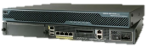
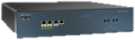
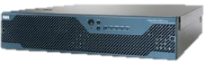
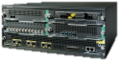
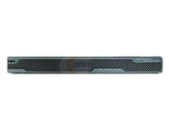
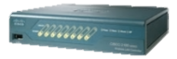
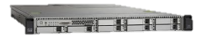
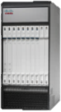
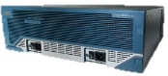
NFV
dDOS
SBC
Firewall
NAT
VM
VM
VM
VM
CGN
DPI
IPS
Virus Scan
VM
VM
VM
VM
DHCP
DNS
PCRF
Portal
VM
VM
VM
VM
WLC
RaaS
SDN Ctrl.
BRAS
VM
VM
VM
VM
NMS
Caching
CDN
WAAS
VM
VM
VM
VM
Concept
  Leverage data centre tools and technology
  Run network functions in VMs in data centers
Enablers
  Hypervisor and cloud computing technology
  Improving x86 h/w performance
Value Proposition
  Shorter innovation cycle
  Improved service agility
  Reduction in CAPEX and OPEX
Applications
  CCAP?

Slide 28
vCCAP?
With Remote PHY
  CCAP -> CCAP core + Remote PHY
With no RF interfaces CCAP core is a canditate for virtualization
  vCCAP runs in VM on standard server platform with Ethernet interfaces
CCAP = CMTS +EQAM
  vCCAP is actually vCMTS + vEQAM
  CCAP becomes vCMTS + vEQAM + R-PHY
CCAP
CCAP
CCAP
CCAP
VM
VM
VM
VM
CCAP
CCAP
CCAP
CCAP
VM
VM
VM
VM
CCAP
CCAP
CCAP
CCAP
VM
VM
VM
VM
CCAP
CCAP
CCAP
CCAP
VM
VM
VM
VM
CCAP
CCAP
CCAP
CCAP
VM
VM
VM
VM

Slide 29

Why NFV?
NFV is a direction that Service Providers are headed in an effort to reduce OPEX
It allows a generic hardware complex with specialized software applications.
It trades off specialized hardware for less optimized common platforms
It uses standard management and orchestration tools
NFV and Orchestration required is not simple but
  It is heavily leveraged from the data center
  It is mainstream technology
  It could have significant advantages especially for scaling & OPEX
Physical versus virtual will be a choice

Slide 30
Evolved Network Infrastructure
Products
Applications & End to End Connectivity
Applications
Residential & Business Services Applications
Evolved Services Platform
Orchestration
Installed Base
+ CCAP
CCAP-Core
NFV
FTTx OLT
Ethernet
HFC
Plant
RPHY
SHELF
RPHY
NODE
ONT
NID
- Classic HFC
Small Hub
Linear Fiber
Deep Fiber
Digital Fiber
High SLA Commercial
Select Residential

Slide 31
Gerry White
gerrwhit@cisco.com

