Slide 1
Piedmont SCTE Meeting
SEMI - SMS

Slide 2
SEMI and SMS Background
  SEMI kicked-off December 2009 at Cox in Phoenix
  Sustainability Management Subcommittee formed September 2010

Slide 3
Problem we are trying to solve
Material reduction in energy conservation
Material increase in density
Material improvement in MTBF

Slide 4
SMS Focus
Building Level:
SMS 001 Facilities Recommended Practices for Critical Facilities
Rack/Equipment Level:
SMS 002 Product Environmental Requirements
EMS Interface Level:
SMS 003 APSISTM – Adaptive Power Systems Interface Specifications

Slide 5
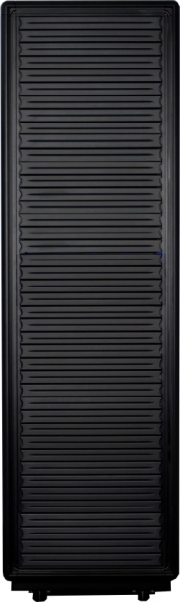
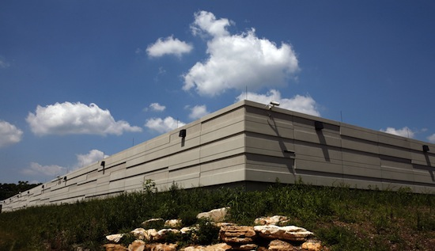
SCTE Standards
Sustainability Management
Subcommittee
Product Environmental Requirements – SMS 002
Critical Facilities –
SMS 001

Slide 6
SMS 001
Thank You Team
  Charter: Jeff Nelson
  Cisco: Fred Hirt
  Comcast: David Mendo and Richard Werner
  CommScope: Mark Alrutz and Masood Shariff
  Coppervale: Dr Rene Spee
  Rogers: Adnan Korkomaz
  Time Warner: Dan Cooper and Stephanie Trotter
  SCTE: Derek DiGiacomo and Steve Hughey
  WES*: Jason Squitieri and Mark Welsko

Slide 7
SMS 001
Purpose
Publish best practices surrounding energy management in mission critical facilities (hubs and datacenters) resulting in increased operating efficiencies.

Slide 8
SMS 001
Scope
Concentrate on 24x7 mission critical space considerations for driving down energy costs.
Not included – outside plant, office space, warehouse space

Slide 9
SMS 001
Energy Efficiency
Alternate Power, Energy Savings Design
Contaminant Management
Air Quality
Fire, Safety & Security
Detection, Suppression and Personal Safety
Environmental Monitoring & Building Management
Building Management Systems, Alarming, Monitoring, Reporting and Auditing
IT Systems & Data Communications
Cabinet Placement, Cabling, IT Equipment
Management

Slide 10
SMS 001
General Design Considerations
Flexibility, Growth & Scalability and Availability & Efficiency
Site Location
Security, Accessibility, Metrics and Benchmarking
Building & Room Construction
Exterior Building Construction, Equipment Room Construction, Receiving, Staging and Storage
Electrical Systems
Utility Power, Generators, UPS, Redundancy Considerations
Cooling Systems
Temperature, Mechanical Equipment Design, Controls

Slide 11
SMS 001
Final draft to be released Q4 2011
Q4 2011
9/15
SMS to review document and open vote

Slide 12
SCTE Standards
Sustainability Management
Subcommittee
Product Environmental Requirements – SMS 002
Critical Facilities

Slide 13
SMS 002
Purpose
Write a specification to provide physical, environmental, and sustainability requirements for cable telecommunications products deployed in environmentally controlled cable telecommunications facilities
To consolidate existing product environmental requirements criteria for reasonably available technical sources into a single specification
To add content as needed to define cable telecommunications equipment specific requirements.
It IS NOT the intent of this specification to replace existing
standards or test procedures

Slide 14
SMS 002
Scope
Define key physical, environmental, and sustainability requirements during transportation, storage, and operation
Limited to indoor equipment frame and shelf level cable telecommunications equipment
Cable Telecommunications Facilities for which this specification generally applies
Mission critical environmentally controlled 24/7/365 Network Data Centers, cable head ends
Environmentally protected cable facilities essential to cable plant operation but which may be unmanned such as cable hubs
Less tightly controlled environmental limits
Longer duration environmental stresses
DOES NOT address requirements for outside cable plant equipment or
customer premise equipment (CPE)

Slide 15
SMS 002
1
Review Published Standards
2011
2
Draft Working Document
2011
3
Interview MSO Participants
2011
4
Involve SCTE Standards Vendor Community
2011
5
Form Working Group
2011
6
Publish Standard
2012
Notes:
Look into cable efficiency for cable products

Slide 16
SMS 002
Introduction
Background information
Physical Requirements
Frame, Load, Airflow, Heat Release
Environmental Requirements
Transportation, Vibration, Shock, Contaminants, Safety
Electrical Requirements
ESD, EMC, Grounding and Bonding
Sustainability Requirements
Energy Efficiency, Life Cycle
Quality Requirements
Service Life Predictions, Reliability Expectations

Slide 17
SMS 003
APSISTM
  Adaptive Power Systems Interface Specification

Slide 18
SMS 003 - TBEC
Transactional Based Energy Consumption
  Energy consumption enabled when traffic or service feature is functional required to facilitate or complete a transaction
  Separating unused features from the power supply
  Dormancy mode
  Throttling processes
  More…

Slide 19
APSIS Features
Default: Programmable
Traffic: Normal
Traffic: Priority
Profile: Demand
Profile: DR Coonsumption/Control Mode

Slide 20
APSIS
Adaptive Power Systems Interface Specification
“System based” TBEC: elements provisioned to reduce energy consumption correlated to traffic demand, predicted or real-time load management.
100%
Traditional Static Energy Consumption
Capacity
Delta - Energy Consumption 30-60%
= Programmed
= Dynamic
12 Mid
Time correlated to typical traffic histogram
12 Mid

