Slide 1
WHAT’S NEW IN THE SCTE
Piedmont Chapter Meeting
21 September 2011
Daniel Howard
SVP Engineering and CTO, SCTE

Slide 2
NEW CTO
15 yrs on Ga Tech faculty
Co-founded GT Broadband Telecom Center
Co-founded Digital Furnace, cable startup from Ga Tech
Broadcom acquired DFC in 2000
  Helped develop Broadcom’s version of S-CDMA
  Lead author on Broadcom primary channel bonding patent
Left Broadcom to do interactive TV startup (#2)
  Marriage of Google and TV, new ad models for TV
Joined Motorola
  Capacity modeling and IPTV architectures as focus
Left Moto to do VQLink (startup #3)
  No-reference goldeneye type video quality measurement (MOS probe)
Stolen by Mark Dzuban last July to be first SCTE CTO

Slide 3
CTO MISSION AT SCTE
Participate in establishing the cable industry’s technology vision
Help develop and use their technology requirements for SCTE mission
  Drive professional development, standards and content creation
Support relevant peer organizations: CableLabs, CTAM, and NCTA
Identify new standards and education resources specifically for:
  Technology strategy and migration to all-IP, unified network
  Next-generation network architecture, consumer technologies, and advertising methods
  Future SCTE initiatives: Energy, business services, operations
Expand existing and develop new PD content
  Build more diverse team to more directly support the industry

Slide 4
OK, so what has SCTE done for us Techs lately?
18 New Primers, 2-3 new ones per month
  Spanish and German translation underway
E-courses
  Understanding Cable Technology
  Fundamentals of IP Networking
  Impact of Going All Digital
New BPI/T certification resources
  Manual: Aug/Sept availability
  E-courses: 4Q11 availability
  Updated BPI/T certification: 4Q11
Joint SCTE-Arris Pocketguide

Slide 5
SCTE Primers
Primers now available on WWW.SCTE.ORG:
What are... Carrier Ethernet Attributes?
What is...Carrier Ethernet?
What is...eWaste?
What is... Fiber Cleaning?
What is…Hex?
What is...IPv6?
What is…MoCA?
What is…MoCA?
What is…MoCA Home Networking?
What is...OMI?
What is…MoCA 2.0?
What is…Power Theory?
What is...Project Management?
What is…RF Theory?
What is...R and U Value?
What is...Skin Effect?
What is…Terminated Connector Performance?
What is...Theft of Service?
Notes:
A few Primers in progress…

Slide 6
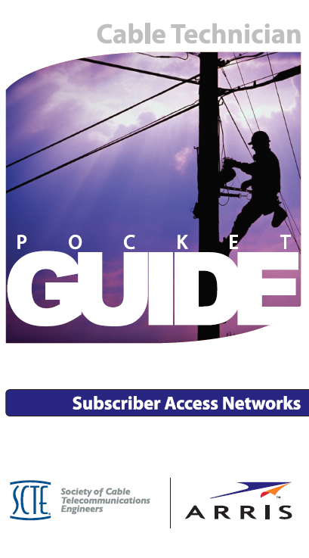
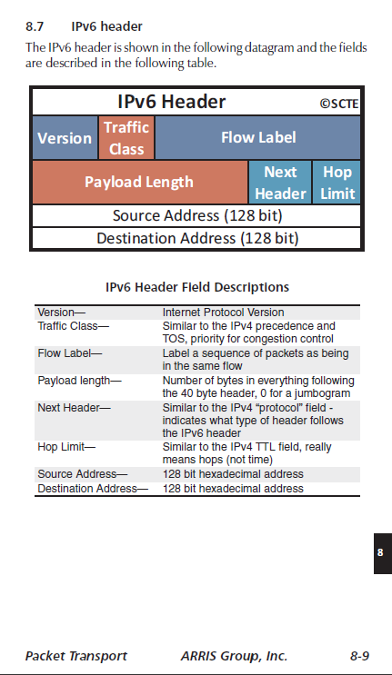
JOINT SCTE-ARRIS POCKET GUIDE WITH NEW IP SECTION
Looks great on mobile phones as well!

Slide 7
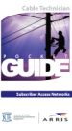







SCTE-VENDOR POCKETGUIDES:
SPANNING THE WORKFORCE NEEDS
1H/13
???-SCTE Business Services Guide
1H12
2H/12
CommScope-SCTE Wireless Guide
TBD-SCTE CE/Installer PocketGuide
Cisco-SCTE IP PocketGuide
1H12
2H11
Alpha-SCTE Energy/Facility PocketGuide
2H11
Motorola-SCTE Distribution Guide
Release Date
2H10
Arris-SCTE Cable Technician Guide
HUB
eMTA
Regional
Network
(Aggregate Network)
National
Backbone
(Core)
Master Media Center
Wireless Router
STB
POP
HUB
HUB
Network Depth

Slide 8
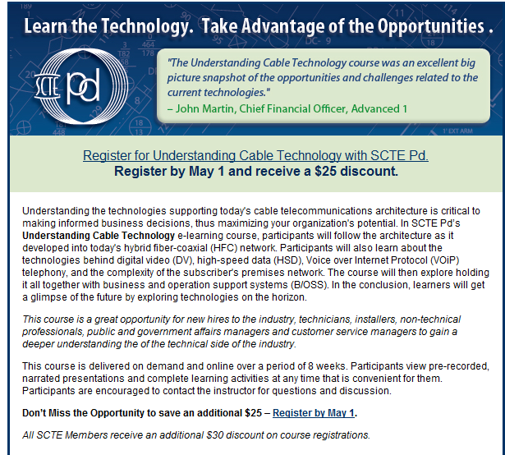

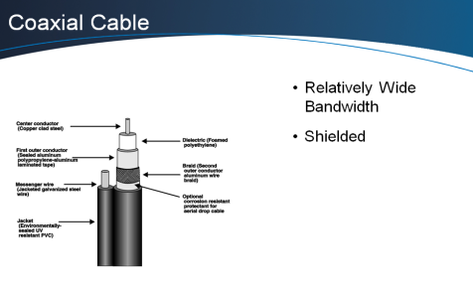
NEW SCTE E-COURSE:
UNDERSTANDING CABLE TECHNOLOGY
Cable basics for new hires, technicians, non-technical professionals, government affairs managers, and CSRs

Slide 9
OK, SO WHAT ABOUT SUPERVISORS, ENGINEERS AND CHAPTER LEADERS?
Supervisor 101 symposium developed, first launch at New England Chapter this fall
  Will become national program at Chapter Leadership Conference
Capacity management/planning symposium at EXPO this year
LiveLearning Webinars: renewed emphasis on operations and new technology
New technical journal, 1Q12 launch
New DOCSIS training, jointly developed with CableLabs, 3Q11 and potential DOCSIS certification
New Digital Video training (currently onsite, soon to be e-course)
IPTV working group almost complete with compencies, training content already in development
University partnerships

Slide 10
Live LearningTM Webinars
DTV, IP, and IPv6
End-to-End Traffic Engineering -- Challenges and Considerations
IP 101
IPTV a.k.a. Video Over IP
IPTV: How It Works and How to Monitor/Troubleshoot It
IPv6: Deployment Issues and Challenges
IPv6 in the Data Center
Should Cable Move to IPTV via Video Over DOCSIS?
The Path to IPv6 in Cable Networks
Troubleshooting MPEG2
Emergency Alert System (EAS)
Emergency Alert System (EAS) - Is Your System Ready?
Fiber Transport
FTTx: Friend or Foe?
Cable’s Fiber to the Home (PON over HFC network to the Premises)
Fundamentals
IP for the Cable Engineer
HDTV/3DTV
3DTV: Delivery to the Home
An Overview of the DOCSIS® Set-top Gateway Protocol
HFC Systems
Characterizing Signal Leakage From an All-Digital Cable Network
Managing Linear and Non-Linear Distortions in HFC Systems
The National Electrical Code: Why Comply?
PacketCable™
An Overview of IP Multimedia Subsystem (IMS)
PacketCable™: Architecture, Equipment and Transport
Moving to PacketCable™ 2.0
Network Infrastructure, IMS, SIP and PacketCable 2.0™ - Should We Do It?
PacketCable™ Multimedia (PCMM): More Than Just VoIP
PacketCable™ Reliability in the Outside Plant
Downloadable DOCSIS Checklist for the PacketCable™ Reliability in the Outside Plant seminar
PacketCable™: Provisioning the Service and Guaranteeing Quality
Switched Digital Video
A View From the Top: Switched Digital Video
Switched Digital vs. All Digital
VoIP
Troubleshooting VoIP in a DOCSIS Network
VoIP Protocols: SIP and MGCP/NCS - SIP and MGCP/NCS
Trends in Cable Telecommunications: What's Next?
Wireless Technology
802.16 - WiMAX and WMAN: Opportunity or Threat?
Seamless Mobility
The Integration of Wi-Fi and WiMAX in HFC
Advanced Advertising
Advanced Advertising in the All-Digital Network
Understanding the SCTE 130 Technical Framework
Business Services
Cell Backhaul - Testing and Monitoring Best
Meet SLA requirements
Enabling Technologies for Profitable Ethernet Services
How Does Cellular Backhaul Work?
How to Ensure the Big One Doesn't Get Away
Update on CableLabs® Business Services Specifications
Winning Architectures for Cable's Business Services 2008
Migrating to Business Ethernet Services
Service Management
Digital Rights Management - Extending Conditional Access Throughout the Home
The Holy Grail of Flow - Through Provisioning
DOCSIS®
Bandwidth Management and the Impact of DOCSIS® Channel Bonding
DOCSIS 3.0 - It's Deployment Time
DOCSIS® 3.0 Revisited
IP Video over DOCSIS® Networks
Monitoring and Managing a DOCSIS™ 3.0 Network
The DOCSIS® M-CMTS™ Architecture
Home Networking
Distributing Video in a Whole-home Application Securely and Efficiently
Home Networking Technologies
In-Home Support Services
The Emerging In-Home Network, Here Comes Video!
Networks
Carrier Grade Ethernet
Carrier Grade Ethernet: Is Your Network Prepared?
CWDM/DWDM - Bandwidth Demand Tamed
Deploying Ethernet Transport: Engineering Best Practices
Ethernet Service Testing and Monitoring
Metro Ethernet and Carrier Grade Ethernet in the HFC Network
Migrating to Business Ethernet Services
Next Generation Networks: Speed, Services and Solutions – The Cable Network of the Future
OCAP
Tru2way, OCAP and EBIF - What it means for MSOs
Live LearningTM Archives
Notes:
SCTE Live Learning Webinar
Definition: One-hour technical web-based seminar, typically a “cutting edge” topic. SCTE LiveLearning is free to members and $29 to non-members. Members also have access to archived LiveLearning webinars.
Format: Facilitated live webinar offered at 2:00PM ET the 3rd Wednesday of each month; PPT.
Where reside: SCTE website (link sent to those who register)
Primary authors: PD team with vendor partner
Audience: Designed typically for levels 2 and above.

Slide 11
Current and Potential PD Courses
Virtual Classroom Course Offerings Available in 2010
Home Networking *
IPv6: Impact on Cable Networks *
Channel Bonding in DOCSIS 3.0 *
Fundamentals of SDV, Digital Video and MPEG Video *
Ethernet Transport *
Overview of IMS & SIP - PacketCable™ 2.0 *
CCNA1 Discovery: Networking for Home and Small Business
CCNA2 Discovery: Working at a Small-to-Medium Business/ISP
CCNA3 Discovery: Introducing Routing and Switching in the Enterprise
CCNA4 Discovery: Designing and Supporting Computer Networks
CCNA Security
* Also available On-Demand
Virtual Classroom Course Offerings Possible for 2011
Juniper Networks Technical Certification Program (JNTCP)
Red Hat Certified Engineer (RHCE)
On-Site Offerings Available
Cable Technology for the Nontechnical Professional
CCNA1 Boot Camp: Networking for Home and Small Business
CCNA2 Boot Camp: Working at a Small-to-Medium Business or ISP
Channel Bonding in DOCSIS® 3.0
Digital Basics and DOCSIS® Fundamentals
DOCSIS® Systems
Ethernet Transport
Fundamentals of SDV, Digital Video and MPEG Video
IPv6: Deployment Issues and Challenges
Return Path
Train the Trainer
Troubleshooting Voice over Internet Protocol (VoIP)
Certified Wireless Technical Specialist
Linux Essentials

Slide 12
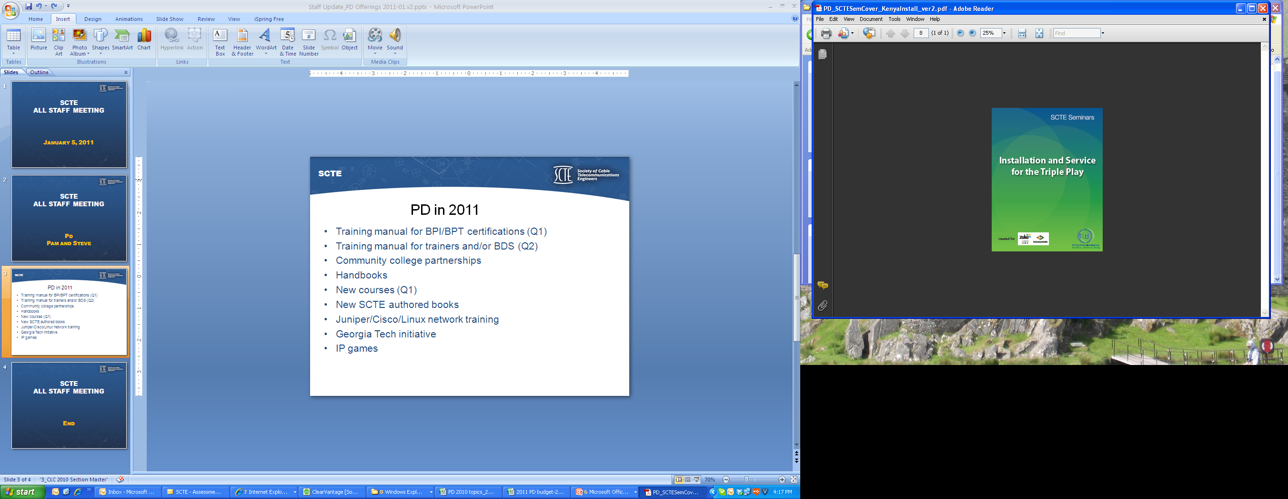
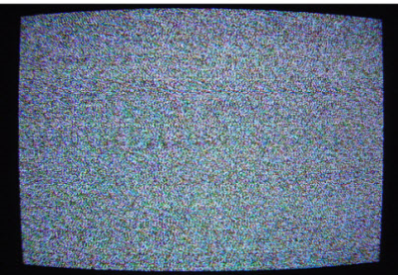
new scte offerings in 2011
Online delivery of courses (Q1)
Training manual for BPI/BPT certifications (Q1)
BPI/BPT Leaders Guide (Q2)
Training program w/ CommScope for BDS (Q2)
Handbooks (Arris, Cisco, Alpha)
New courses (Q1)
New SCTE authored books (2H)
Juniper/Cisco/Linux network training
IP games (2H)

Slide 13
SCTE Primers:
SCTE has a wide range of fifteen minute primers coming out soon that answer the question: “What is…, and why is it important?”
A brief listing of upcoming primers is shown below, with many more planned for the near future.
What is IPv6?
What is Fiber Cleaning?
What is Carrier Ethernet?
What is 3DTV?
What is Copper Testing?
What is Digital Sampling?
What is Encoding?
What is e-Waste?
What is Fuel Cell Technology?
What is GPS-Based Fleet Management?
What is Base-Hexadecimal Numbering?
What is IPv6 Address Planning?
What is MoCA?
What is MPEG over Wireless?
What is Optical Modulation Index?
What is Pareto Analysis?
What is Power Theory?
What is QAM Channel Insertion? (#1 in a series)
What is RF Theory?
What is RF Upconversion ?
What is R-factor and U-factor?
What is the Skin Effect?
What is Spectral Analysis?
What is a Trouble Call?
Notes:
A few Primers in progress…

Slide 14
Live LearningTM Webinars
Upcoming Live LearningTM Webinar:
IP 101 for Cable Professionals
DTV, IP, and IPv6
End-to-End Traffic Engineering -- Challenges and Considerations
IPTV a.k.a. Video Over IP
IPTV: How It Works and How to Monitor/Troubleshoot It
IPv6: Deployment Issues and Challenges
IPv6 in the Data Center
Should Cable Move to IPTV via Video Over DOCSIS?
The Path to IPv6 in Cable Networks
Troubleshooting MPEG2
Emergency Alert System (EAS)
Emergency Alert System (EAS) - Is Your System Ready?
Fiber Transport
FTTx: Friend or Foe?
Cable’s Fiber to the Home (PON over HFC network to the Premises)
Fundamentals
IP for the Cable Engineer
HDTV
An Overview of the DOCSIS® Set-top Gateway Protocol
HFC Systems
Characterizing Signal Leakage From an All-Digital Cable Network
Managing Linear and Non-Linear Distortions in HFC Systems
The National Electrical Code: Why Comply?
PacketCable™
An Overview of IP Multimedia Subsystem (IMS)
PacketCable™: Architecture, Equipment and Transport
Moving to PacketCable™ 2.0
Network Infrastructure, IMS, SIP and PacketCable 2.0™ - Should We Do It?
PacketCable™ Multimedia (PCMM): More Than Just VoIP
PacketCable™ Reliability in the Outside Plant
Downloadable DOCSIS Checklist for the PacketCable™ Reliability in the Outside Plant seminar
PacketCable™: Provisioning the Service and Guaranteeing Quality
Switched Digital Video
A View From the Top: Switched Digital Video
Switched Digital vs. All Digital
VoIP
Troubleshooting VoIP in a DOCSIS Network
VoIP Protocols: SIP and MGCP/NCS - SIP and MGCP/NCS
Wireless Technology
802.16 - WiMAX and WMAN: Opportunity or Threat?
Seamless Mobility
The Integration of Wi-Fi and WiMAX in HFC
Advanced Advertising
Advanced Advertising in the All-Digital Network
Understanding the SCTE 130 Technical Framework
Business Services
Cell Backhaul - Testing and Monitoring Best
Meet SLA requirements
Enabling Technologies for Profitable Ethernet Services
How Does Cellular Backhaul Work?
How to Ensure the Big One Doesn't Get Away
Update on CableLabs® Business Services Specifications
Winning Architectures for Cable's Business Services 2008
Winning Architectures for Cable's Business Services 2009
Service Management
Digital Rights Management - Extending Conditional Access Throughout the Home
The Holy Grail of Flow - Through Provisioning
DOCSIS®
Bandwidth Management and the Impact of DOCSIS® Channel Bonding
DOCSIS 3.0 - It's Deployment Time
DOCSIS® 3.0 Revisited
IP Video over DOCSIS® Networks
Monitoring and Managing a DOCSIS™ 3.0 Network
The DOCSIS® M-CMTS™ Architecture
Home Networking
Distributing Video in a Whole-home Application Securely and Efficiently
Home Networking Technologies
In-Home Support Services
The Emerging In-Home Network, Here Comes Video!
Networks
Carrier Grade Ethernet
Carrier Grade Ethernet: Is Your Network Prepared?
CWDM/DWDM - Bandwidth Demand Tamed
Deploying Ethernet Transport: Engineering Best Practices
Metro Ethernet and Carrier Grade Ethernet in the HFC Network
Migrating to Business Ethernet Services
Next Generation Networks: Speed, Services and Solutions – The Cable Network of the Future
OCAP
Tru2way, OCAP and EBIF - What it means for MSOs
Live LearningTM Archives
Notes:
SCTE Live Learning Webinar
Definition: One-hour technical web-based seminar, typically a “cutting edge” topic. SCTE LiveLearning is free to members and $29 to non-members. Members also have access to archived LiveLearning webinars.
Format: Facilitated live webinar offered at 2:00PM ET the 3rd Wednesday of each month; PPT.
Where reside: SCTE website (link sent to those who register)
Primary authors: PD team with vendor partner
Audience: Designed typically for levels 2 and above.

Slide 15
Current and Potential PD Courses
Virtual Classroom Course Offerings Available in 2010
Home Networking *
IPv6: Impact on Cable Networks *
Channel Bonding in DOCSIS 3.0 *
Fundamentals of SDV, Digital Video and MPEG Video *
Ethernet Transport *
Overview of IMS & SIP - PacketCable™ 2.0 *
CCNA1 Discovery: Networking for Home and Small Business
CCNA2 Discovery: Working at a Small-to-Medium Business/ISP
CCNA3 Discovery: Introducing Routing and Switching in the Enterprise
CCNA4 Discovery: Designing and Supporting Computer Networks
CCNA Security
* Also available On-Demand
Virtual Classroom Course Offerings Possible for 2011
Juniper Networks Technical Certification Program (JNTCP)
Red Hat Certified Engineer (RHCE)
On-Site Offerings Available
Cable Technology for the Nontechnical Professional
CCNA1 Boot Camp: Networking for Home and Small Business
CCNA2 Boot Camp: Working at a Small-to-Medium Business or ISP
Channel Bonding in DOCSIS® 3.0
Digital Basics and DOCSIS® Fundamentals
DOCSIS® Systems
Ethernet Transport
Fundamentals of SDV, Digital Video and MPEG Video
IPv6: Deployment Issues and Challenges
Return Path
Train the Trainer
Troubleshooting Voice over Internet Protocol (VoIP)
Certified Wireless Technical Specialist
Linux Essentials

Slide 16
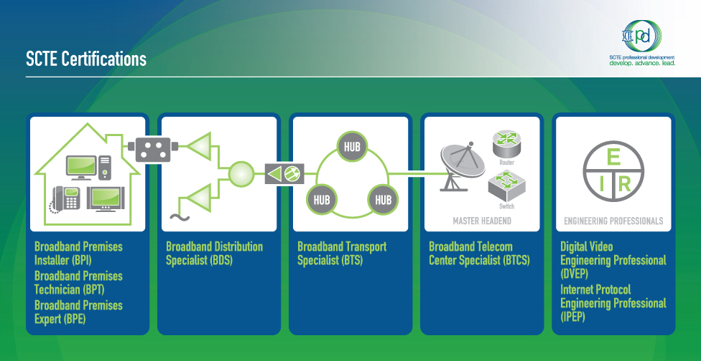
EXTERNAL CERTIFICATIONS SUPPORTED THROUGH SCTE:
  Cisco Certified Network Associate (CCNA)
  Cisco Certified Entry Networking Technician (CCENT)
  Coming soon: CCNP
Notes:
SCTE branded certifications
…plus SCTE offers training that helps prepare the candidate for other external certifications, such as Cisco’s CCNA and CCENT certifications. (To date, there have been 6 certifications awarded to SCTE CCNA students)

Slide 17
Institutional Education Programs
Operator / Vendors
Programs Vs. Workforce
Level 4
Leadership
C-Level Management:
CEOs, COOs, CTOs, CFOs,
CIOs, CSOs, EVPs, SVPs
Dartmouth
Level 3
Optimizing Technology
Senior Management:
General Managers, VPs, Directors
Georgia Tech
Ft. Hayes State University
Level 2
Accredited Program
Rochester Institute of Technology (RIT)
Accredited Program
Operational Management:
Tech Supervisors, Operations
Managers, Consultants
Accredited Program
Accredited Program
Hennepin Technical College
Haywood Community College
Level 1
Customer Facing:
Techs, Installers, CSRs,
Contractors

Slide 18
AND THE MANAGERS, WHAT ABOUT US?
Ga Tech course on Headend/Hub management: 1Q12
Tuck Executive Leadership
  2011 big hit, 2012 already announced
New SMS standard for headend/hub equipment and best practices for headend/hub/datacenter management

Slide 19
SCTE Resources Optimize Education by Time and Complexity
Technical Journal
Certification Prep
InfoScope Archives
Onsite Seminars and Symposia
Virtual Classroom and On-Demand Electronic Courses
White-papers
L
L
Primers
Mobile Apps
Depth of Information
Pocket Guides
Live LearningTM Webinars and Archives
Tech Tips
Tech Fact
1 min
5 min
15 min
30 min
1 hr
1 day
1 wk
1 mo
2 mo
Time to Cover Material
Member benefit
Available to non-members for purchase
Fees, but member discounts available

Slide 20
SCTE “NEW” INDUSTRY Energy Standards
“NEW” INDUSTRY Standards:
New class of “Cable Specific” standards designed to improve HW Density, Energy Conservation and Network Reliability. (Replace Telcordia!)
Development of first two standards (drafts to be unveiled 9/15/2011)
  SMS 001: “Recommended Energy Conservation, Sustainability and Efficiency Practices for Critical Systems”.
  SMS 002: “Product Environmental Requirements for Cable Telecommunications Facilities,” addressing such considerations as temperature, humidity, electromagnetic interference and environmental design.
  Initiate Standards Development: 9/15/2011
  SMS 003: “Adaptive Power Systems Interface Specification (APSIS™)” to drive adaptive energy consumptions in hardware and other devices coming to market in 2013/14 and beyond. To include CE/CPE in partnership with CableLabs.
  Initiate Planning of “high priority” network operations tools: EST/1Q2012
  SMS 004: “Predictive Performance Telemetry” to optimize MTBF (failure signature alarming to reduce “on line” HW failures, increase network availability )
  SMS 005: Graphic & Information Standards to support VIRTUAL facilities trouble shooting
  (Improve MTTR of complex facilities with remote monitoring and intelligent HD/3D graphics)

Slide 21
SCTE Adaptive Power System
Interface Specification (APSIS)
“System based” elements provisioned to reduce energy consumption correlated to traffic demand, predicted or real-time load management.
100%
Traditional Static Energy Consumption
Capacity
Energy Consumption
= Programmed
= Dynamic
12 Mid
Time correlated to typical traffic histogram
12 Mid
Confidential information, subject to non-disclosure agreement
p21

Slide 22
SCTE Adaptive Power System
Interface Specification (APSIS) Timeline
 | 2011 | 2012 | 2013 | 2014 | 2015 | 2016…
APSIS Launch 9/15/2011
Specifications Process *
Manufacturing Cycle
Product Availability Phase 1
Product Availability Phase 2 (SD Enhanced solutions, etc.)
* Specification Process:
Objective definition, existing solutions assessment, gap analysis,
gap closure solutions, system specifications, standards

