Slide 1
Renewable Resources in DC Power June 2011

Slide 2
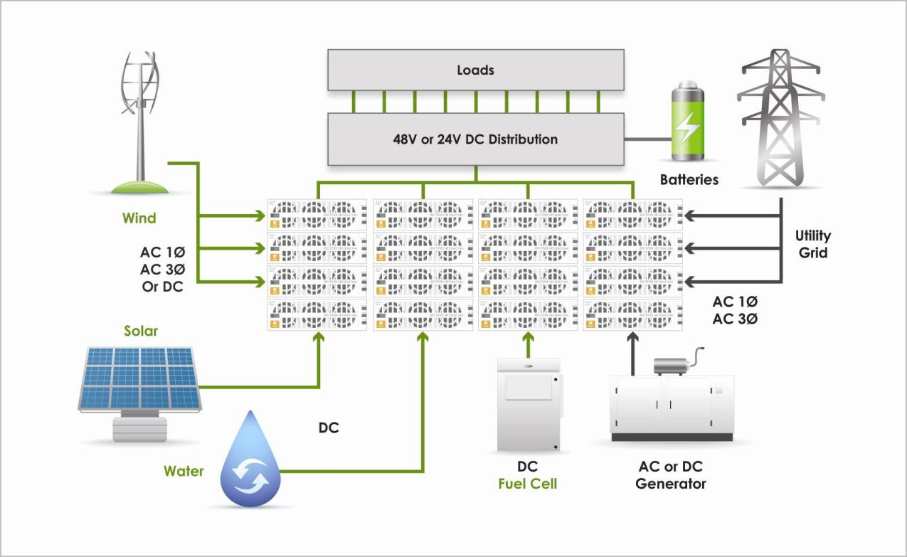
Lineage Eco Priority Source™ Prioritizes clean and green energy sources before generators or the utility grid via Lineage controller/rectifier

Slide 3
Traditional Renewable Resource Power Processing
Solar Power
Load Equipment
DC
Inverter
~
=
Revenue Generation
=
~
=
=
AC Bus
Anti-islanding
grid tie
Transfer
Losses
Conversion
Losses
8%
Transfer
Switch
Back-up
Generator
Conversion
Losses
8%
Conversion
Losses
6%
Heat
Generation
20-90%
Wind Power
Load Equipment
LF
AC
~
=
=
=
Revenue Generation
=
~
~
=
AC Bus
Anti-islanding
grid tie
60Hz
Conversion
Losses
8%
Transfer
Switch
Back-up
Generator
Conversion
Losses
8%
Conversion
Losses
6%
Heat
Generation
20-90%

Slide 4
In the Telecom Environment
Solar Power
Rectifiers
Load Equipment
DC
Inverter
~
=
Revenue Generation
=
~
=
=
AC Bus
Anti-islanding
grid tie
Battery Reserve
Transfer
Losses
Conversion
Losses
8%
Transfer
Switch
Back-up
Generator
Conversion
Losses
8%
Conversion
Losses
6%
Heat
Generation
20-90%
Wind Power
Rectifiers
Load Equipment
~
~
LF
AC
=
~
=
=
Revenue Generation
=
AC Bus
=
Anti-islanding
grid tie
60Hz
Battery Reserve
Conversion
Losses
8%
Transfer
Switch
Back-up
Generator
Conversion
Losses
8%
Conversion
Losses
6%
Heat
Generation
20-90%

Slide 5
The Eco Priority Source™ Rectifier
Solar Power
Rectifiers
Load Equipment
DC
~
=
Revenue Generation
AC Bus
=
=
Battery Reserve
Transfer
Losses
Conversion
Losses
8%
Transfer
Switch
Back-up
Generator
Conversion
Losses
4%
Conversion
Losses
6%
Heat
Generation
20-90%
Wind Power
Rectifiers
Load Equipment
~
=
=
Revenue Generation
AC Bus
=
60Hz
Battery Reserve
Conversion
Losses
8%
Transfer
Switch
Back-up
Generator
Conversion
Losses
4%
Conversion
Losses
6%
Heat
Generation
20-90%

Slide 6
True Eco Priority
Solar Power
Priority
Load Equipment
DC
~
=
=
Revenue Generation
=
Wind Power
Battery Reserve
Priority
LF
AC
~
=
Utility Power
~
AC Bus
=
Eco Priority
Rectifiers
60Hz
Transfer
Switch
Back-up
Generator
Conversion
Losses
4%
Conversion
Losses
6%
Heat
Generation
20-90%

Slide 7
Eco Priority Source™ Key Features
Accepts Power from multiple sources
Prioritizes renewable / green energy sources before generators or the utility grid
Uses the same standard rectifier (part number) for all sources
Solar, wind and other sources
Simplifies ordering, stocking and spare parts inventory
Electronics from a source that you already know and trust
Uses latest TE high efficiency rectifier architecture
Minimizes conversion losses by reducing conversion steps
In a DC telecom application conversions steps reduced to one
Compatible systems already in the field for 3-4 years

Slide 8
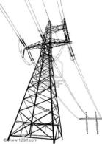
Eco Priority Source™ Mixed Sources
Block Diagram
-48V or +24V
DC Bus
Solar Panel Array(s)
DC Power
Solar Group
Distribution and
Loads
Wind Turbine(s)
AC low frequency
Wind Group
Other Source(s)
AC or DC Power
Priority Group x
Batteries
Utility Source
AC - 60 Hz
Utility Group

Slide 9
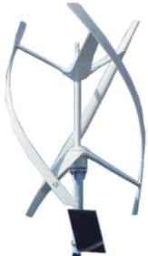
Multiple Wind Sources
Small, Single Phase Wind Turbine
-48V or +24V
DC Bus
Distribution and
Loads
Larger, 3 Phase Wind Turbine
Batteries
Multiple, 3 Phase Wind Turbines

Slide 10
Combining Solar Arrays
Small Solar array, using single dedicated rectifier.
-48V or +24V
DC Bus
Distribution and
Loads
Larger Solar array
9-10 x 270W panels per rectifier
Batteries
Utility Source
AC - 60 Hz

Slide 11
Performance Optimization
Solar
Maximum Power Point Tracking – optimizes power transfer from panels by load V/I optimization
Wide input voltage range (90 – 420VDC) for flexibility
Wind
Start up loading on turbine
Excessive load will stall the turbine
Over speed protection by load application in high wind
General
ECO Sources apply an elevated voltage, current limited source to the battery bus to take priority over non-renewable sources
Simple when ECO source is fractional load requirement
Maximizes use of the renewable sources, minimizes utility use.
High efficiency power conversion
Active Rectifier Management (ARMTM) for conversion efficiency optimization even at low utilization

Slide 12
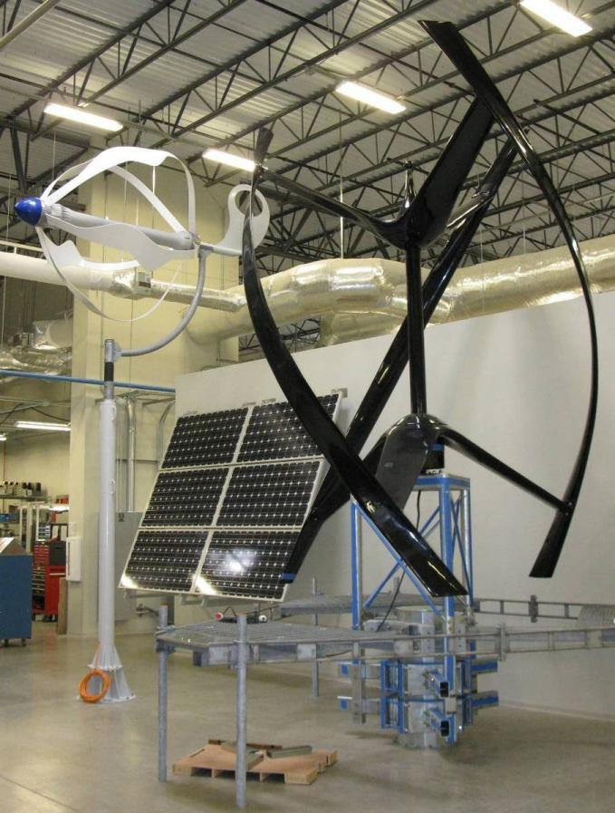
Eco Priority Source Lab
All integrate with Eco Priority Rectifiers
Urban Green Energy UGE-4k
4kW capacity
Cut in wind speed 7mph
Deploy on cell tower stand
Home Energy Americas Energy Ball V200
2.5kW capacity
Cut in wind speed 6.7mph
HPS Solar BPS 175
175w Peak standard test

Slide 13
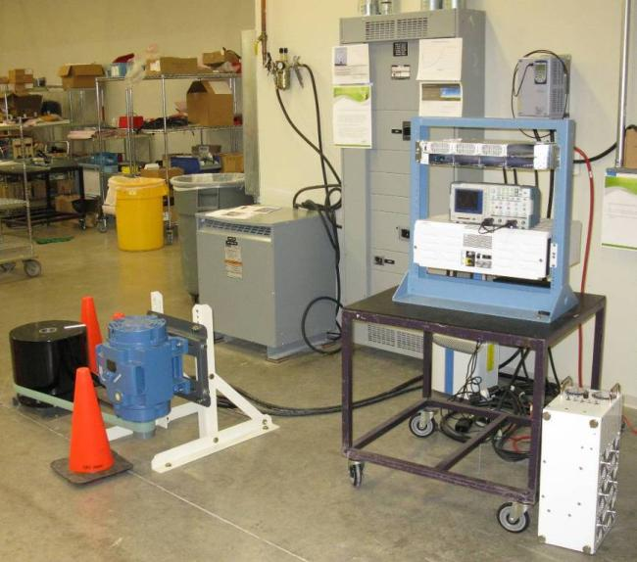
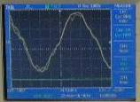
Eco Priority Source Lab
AC input f= ~14hZ, 560Vpp
J2007001L006 -48V CPL System powered from AC output of wind turbine

Slide 14
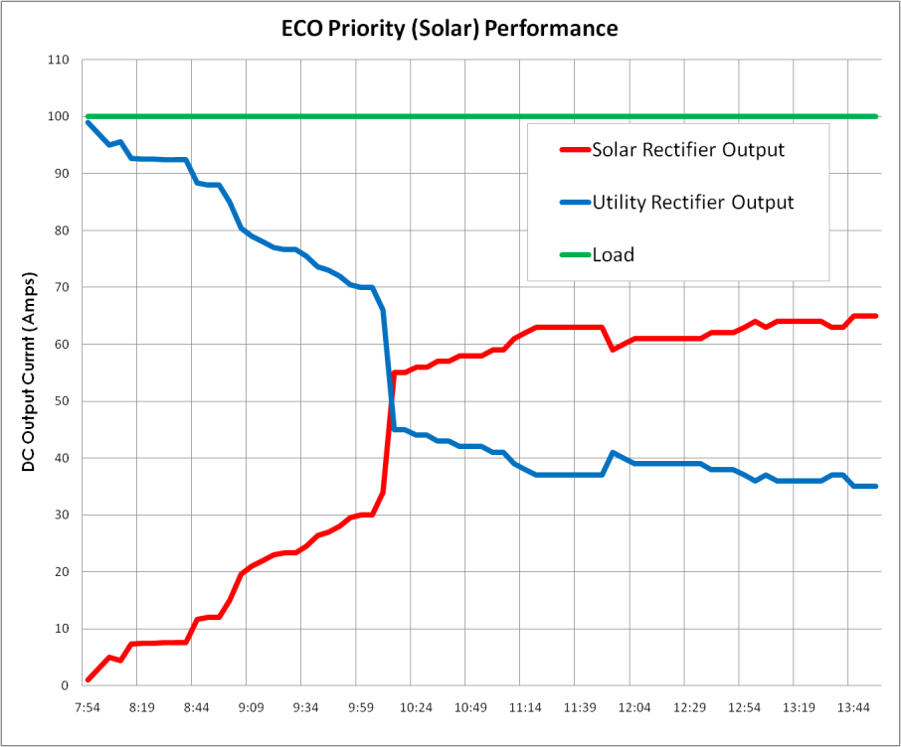
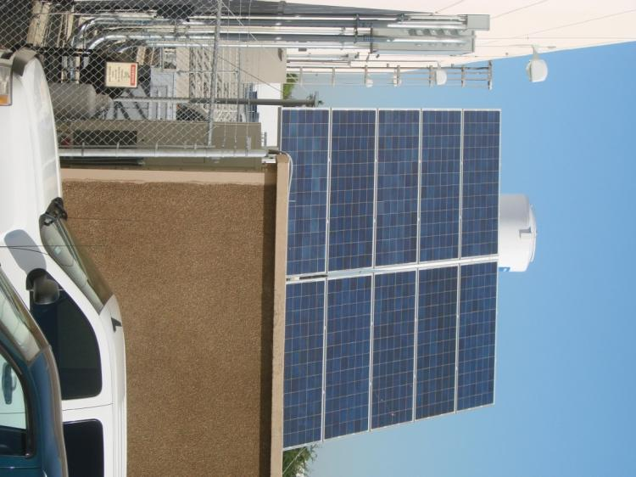
Solar Panel Output with Utility Supplement
As Solar power increases, utility use decreases
Illustration from Plano Trial Site data

Slide 15
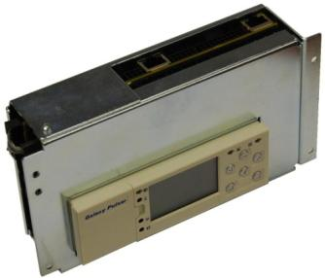
Eco Source Control
Lineage Controller Technology – the heart of an ECO efficient Power System
Prioritizes clean / green energy sources before generators / utility grid
Manages battery charging and discharge cycles (vs ECO source availability)
Optimizes use of ECO Sources
Minimizes Utility Grid Costs (time and rate per Smart Grid Response)
Minimizes fossil fuel usage and costs

Slide 16
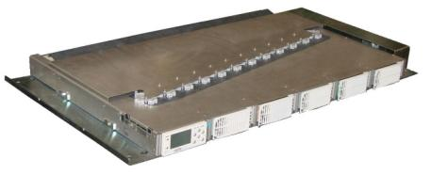
Eco Priority Integration Center
Add ECO Priority source features to an existing power plant
Combine DC Power from multiple sources on the existing DC Bus
Automatic current sharing with Priority to the renewable energy source
Wall mounted Shelf
Frame mounted shelf
Sustainable, AC, and DC power
Single chassis simplifies solar integration
Large Surface for Interconnects
Simplifies input power wiring task
Bulk DC Output
Supports reuse of existing DC distribution for low cost universal retrofits and upgrades of cell sites
-48V DC
Supplement / expand existing power plant with Efficient Renewable Energy processing

Slide 17
True Eco Priority Source Architecture
Solar Power
~
DC
Load Equipment
=
Optional Wind Pwr
~
LF
AC
Battery Reserve
=
Utility Power
~
=
Single Controller
(DC Plant)
Generator 1
~
=
Eco Priority
Rectifiers
Generator 2
~
=
DC Power Plant

Slide 18
ECO Priority Source – Compatible Systems

Slide 19
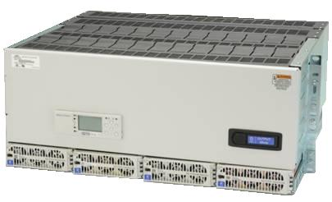
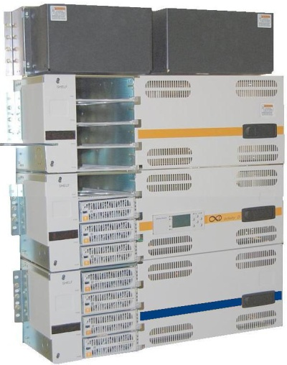
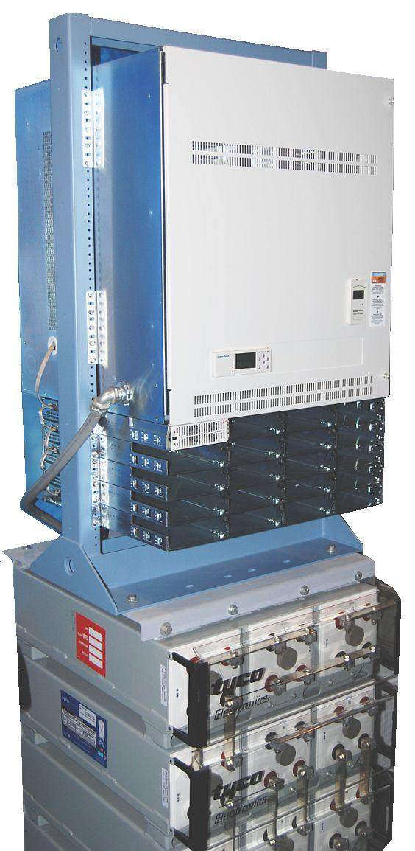
Infinity Systems
Infinity S
Infinity D
Infinity M
Compact power system suited for installation in either a relay rack or cabinet
Ideal for smaller deployment areas with limited space or load requirements
200 – 600 Amp output
26 to 52 plug-in distribution positions
24V, 48V and dual voltage
Medium sized power system suitable for installation in either a relay rack or cabinet
Ideal for deployment in areas with a small, low cost initial requirement but needs future growth capability
200 – 1,600 Amp output
10 to 120 plug in distribution positions
24V, 48V and dual voltage
Medium sized power plant most suitable for mounting in a relay rack (cabinet possible)
Ideal for deployment in larger Cell Sites and small MTSO’s, where growth is predictable
200 – 1,600 Amp output
65 Primary voltage positions and 15 selectable
24V, 48V and dual voltage

Slide 20
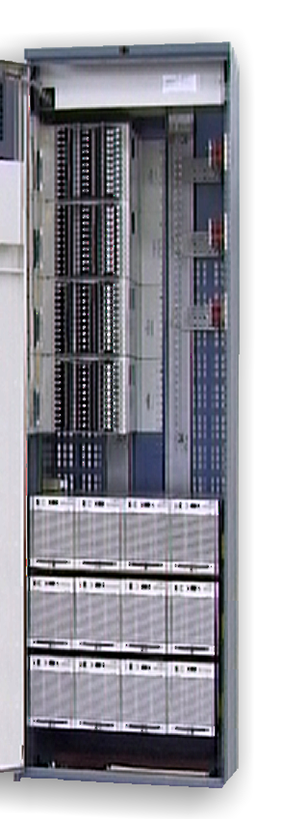
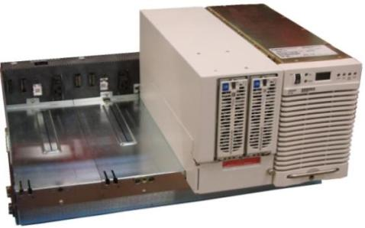
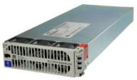
GPS 4812/2424 - Efficiency Upgrade
Features / Benefits:
Lower Cost
High Efficiency
Lower Operating Cost
Controller features enhanced
Retain GPS DC distribution
Retain GPS AC distribution
No Load Distribution Change
Plug and Play upgrade to HE
cCSAus Certified
NEBS Certified Rectifiers
Rectifiers:
NE050AC48TEZ – 50A
NE100AC24TEZ – 24V/100A
96-97% Efficiency
* Standard efficiency rectifiers can not be used
Options:
Replace existing rectifiers as desired
Mix old and new as required
UP to 37 New Rectifier IDs per system
“ID-less” operation for more rectifiers
Controller Upgrade
Controllers:
Vector, Pulsar Plus,
Millennium I or II, Galaxy SC
Applications:
596A or B Rectifier Upgrades in: Cell Sites / MSC, Small CO

Slide 21
GPS 4812/2424 – Full or Partial Upgrades
 | 596 Rectifier | Upgrade Rectifier | Upgrade Rectifier Carrier | Upgrade Kit Rectifier(s) and Carrier
48V, 50A | 596A | NE050AC48ATEZ | CC109168927 | CC109167581
 | 107598120 | CC109158878
48V, 50A | 596A2 | NE050AC48ATEZ
 | 108796400 | CC109158878
48V, 100A | 596D | NE050AC48ATEZ (2) | CC109159918 | CC109167573
 | 108962895 | CC109158878 (2)
24V, 100A | 596B2 | NE100AC24ATEZ | CC109159926 | CC109167598
 | 108067182 | CC109160834
24V, 100A | 596B3 | NE100AC24ATEZ
 | 108036476 | CC109160834
24V, 100A | 596B4 | NE100AC24ATEZ
 | 108687765 | CC109160834
24V, 100A | 596B5 | NE100AC24ATEZ
 | 108969874 | CC109160834
24V, 100A | 596B6 | NE100AC24ATEZ
 | 108982893 | CC109160834
Partial Upgrade:
Lower Cost
Replacement, upgrade or growth
Leave existing rectifiers in place and supplement with Infinity High Efficiency Rectifiers as needed
Full Upgrade:
Maximize efficiency - Replace all existing rectifiers with Infinity High Efficiency Rectifiers
Up to 37 New Infinity Rectifier IDs per system
“ID-less” operation for more rectifiers
Controller Upgrade to enhance features

Slide 22
Upgrade Savings – Utility and HVAC
‡Approximate Savings based on MAX efficiency numbers – See “Cost of PowerTM” calculator for more precise calculations

Slide 23
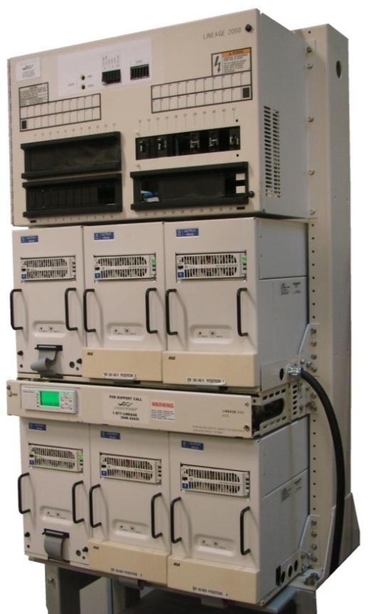
ECS Plant Upgrade
Features / Advantages
High Efficiency
Lower Operating Cost
Retain ECS DC distribution
Controller upgrade
Remote Monitoring
System New Warranty
24V and 48V versions
Rectifiers:
NE050AC48TEZ – 50A
NE100AC24TEZ – 24V/100A
96% Efficiency
Controller:
Pulsar Plus
(ALL Rectifier must be replaced)
Options:
LVBD Interface
Controller upgrade
Battery Slope Thermal Compensation
Battery Mid-String voltage monitoring and imbalance alarm
Applications:
ECS (Lineage 2000) 24V & 48V
J85500D, E, G, models
Cell Sites / MSC
Small to Medium CO

Slide 24
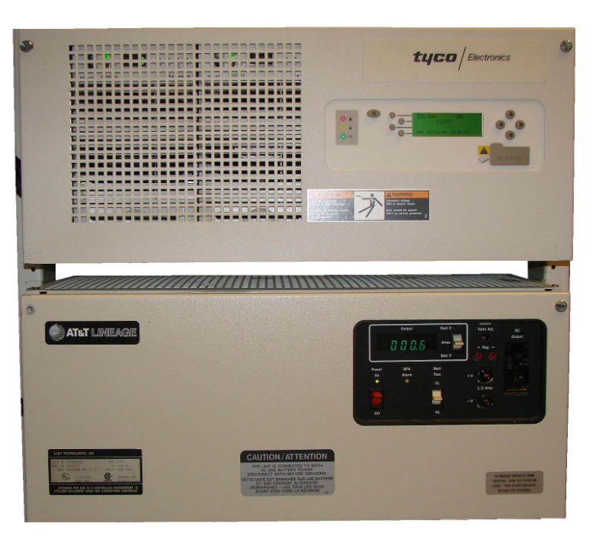
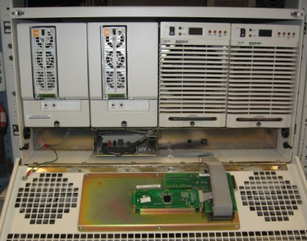
Power Expansion Shelves (PXS) Upgrades
PXS is a system that replaces small Ferros with a shelf of 596 series SMR Rectifiers
Now PXS can be upgraded to Infinity High Efficiency Rectifiers
PXS shelf contains an interface that mimics the parallel interface of the Ferro Rectifier, enabling the Ferro Controller to control 596 Rectifiers indirectly.
In this application Galaxy SC becomes compatible with Infinity Rectifiers
Rectifiers:
NE050AC48TEZ – 50A
NE100AC24TEZ – 24V/100A
96-97% Efficiency
* Standard efficiency rectifiers can not be used
Features / Benefits:
Replaces 596 series rectifiers in PXS application
Lower Cost
High Efficiency
Lower Operating Cost
Plug and Play upgrade to High Efficiency
cCSAus Certified
Controller:
Galaxy SC, CCS, XCS – or other Ferro Plant controller
Applications:
596A or B Rectifier Upgrades in existing PXS Ferro Replacements

Slide 25
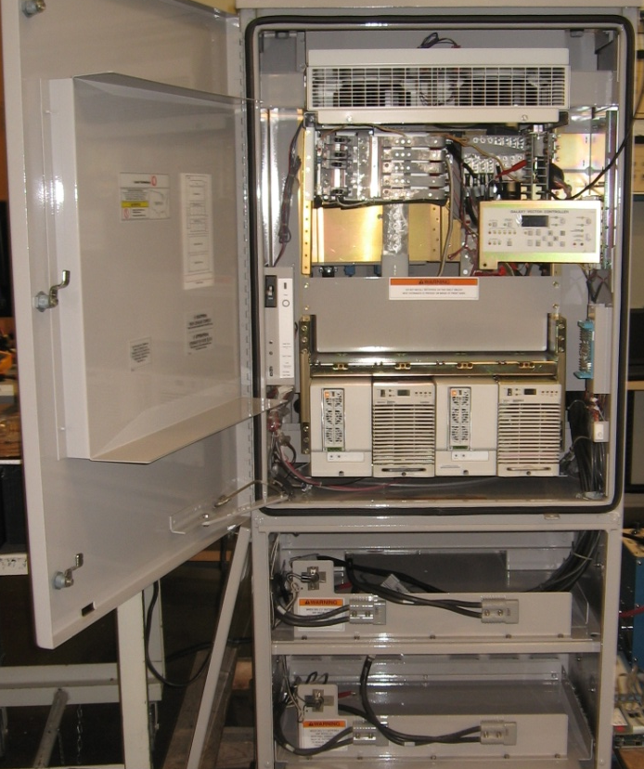
Outdoor Cabinet Rectifier Upgrades
J85702G-1 and other shelves integrated in various outdoor cabinets with 596 series SMR rectifiers can be upgraded to Infinity High Efficiency Rectifiers
System shelves in cabinets must have been spaced to handle the taller 9” high 596 series
Retrofit can be used to replace shorter 5.25” 596B6 if shelves properly spaced
In these applications Galaxy Vector becomes compatible with Infinity Rectifiers
Rectifiers:
NE050AC48TEZ – 50A
NE100AC24TEZ – 24V/100A
96-97% Efficiency
* Standard efficiency rectifiers can not be used
Powerhouse 24
Features / Benefits:
Replaces 596 series rectifiers in cabinet applications
Lower Cost
High Efficiency
Lower Operating Cost
Plug and Play upgrade to High Efficiency
cCSAus Certified
Controller:
Galaxy Vector
Applications:
596B or A series rectifier upgrades in existing cabinet applications

Slide 26
Summary
Eco Priority Source is:
A telecom powering method that allows a network operator to seamlessly integrate power from different sources.
Commercial, local diesel generation and local renewable sources are and will be supported, using a single standard power processing module
Deployments of current Infinity Power Systems are compatible with all Eco Priority Source Rectifiers
Solar powered Eco Priority Source Rectifiers currently deployed in a Cell Site application by a major US Service Provider

Slide 27
GE Renewable Components and Turn-Key Projects

Slide 28
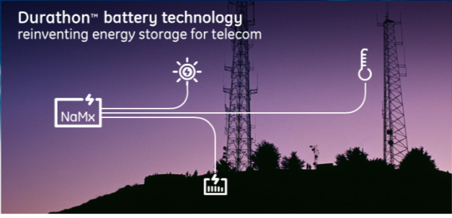
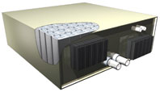
GE Durathon Battery
Sodium metal halide chemistry
Suitable for extreme temperatures
Small footprint
Long life – up to 20 years
High density & high reliability
Deep discharge, fast recharge and frequent cycling capabilities
Produces no toxic chemicals, recyclable, and has remote-monitoring capabilities
The product of a $160 million investment by GE - reduces operating costs, eases use of renewable energy sources, and enables greater off-grid/smart grid deployment flexibility

Slide 29
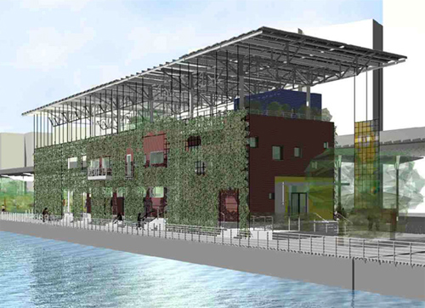
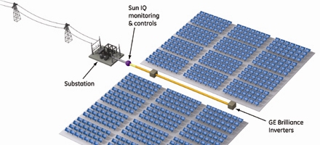
GE Solar Technologies
GE announced the highest-ever reported efficiency for CdTe thin film solar panels - achieved nearly 13 percent efficiency, as measured by the National Renewable Energy Lab (NREL)
To make the technology, GE plans to build the largest solar plant in the USA - part of an expected $600 million plus investment made by GE in solar technology and commercialization
Residential
Inverter 2-5 kW
Commercial
Inverter 10-30 kW

Slide 30
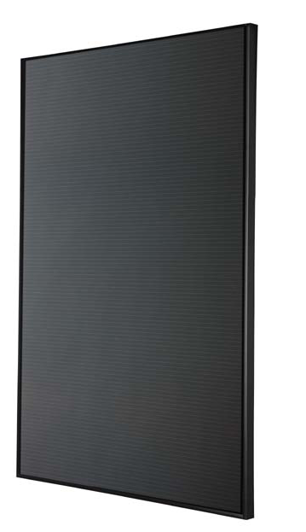
GE CIGS Solar Panels
Incorporates the latest advancements in thin film PV module technology
CIGS thin film module has a framed, dual glass structure to allow for more durability in extreme weather conditions such as snow, hail, and wind.
The GE-CIGS150 module will reach peak powers up to 150 watts at 79 volts and has been designed for long life in harsh environments.
Out-performs traditional PV in low-light and high-temperature applications
Real world performance indicates more than a 4% conversion benefit with the CIGS thin film over prior poly crystalline panels

Slide 31
Turnkey Solutions
GE Solar Technology
The best in the industry
GE Durathon Battery
Ideally suited to application
GE / Lineage DC Power
The best in the industry
Efficiency
Reliability
Systems Integration
Renewables integration
Site Engineering
Installation
Monitoring
“ “
Suitable for extreme temperatures
Small footprint
Long life – up to 20 years
Deep discharge
Fast recharge
Frequent cycling capabilities

Slide 32
Turnkey Solutions
GE Durathon Battery
Ideally suited to Solar application
Advantage | Durathon | VRLA
Round Trip Charge Efficiency | 92% | 80%
Charge Rate | 90% | 80%
Depth of Discharge (daily cycles) | 80% | 40%
Example:
Generator Run | 14 hr/wk | 15 hr/wk
Battery Capacity | 1,250AHr | 5,000AHr
Air-conditioning | Minimal | 4,000Whr / day

Slide 33
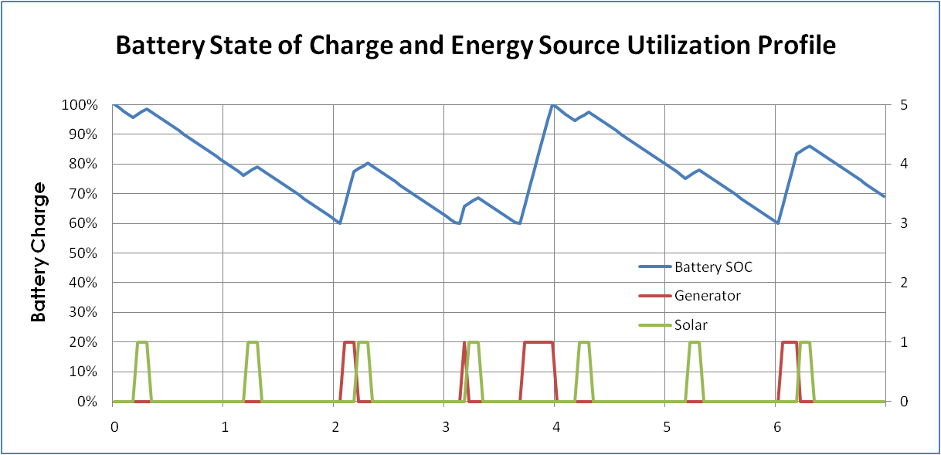
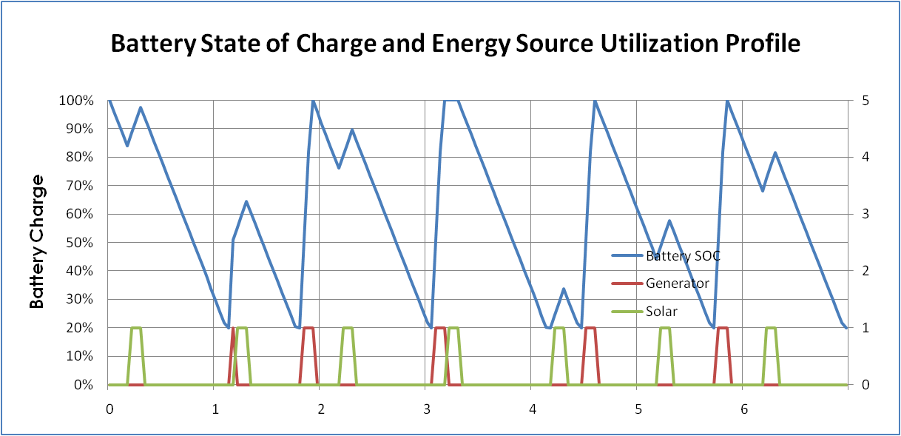
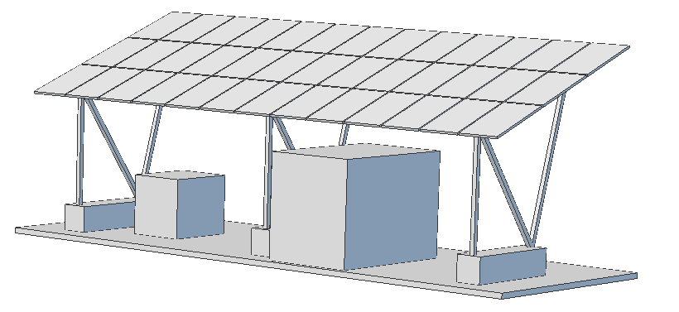
Turnkey Solutions
Havasu Pass site configuration
- VRLA battery @5,000 Ahr
- Generator runs 15 hr/wk
Havasu Pass site configuration
- Durathon battery @1,250 Ahr
- Generator runs 14 hr/wk

Slide 35
Appendix

